Slide 1

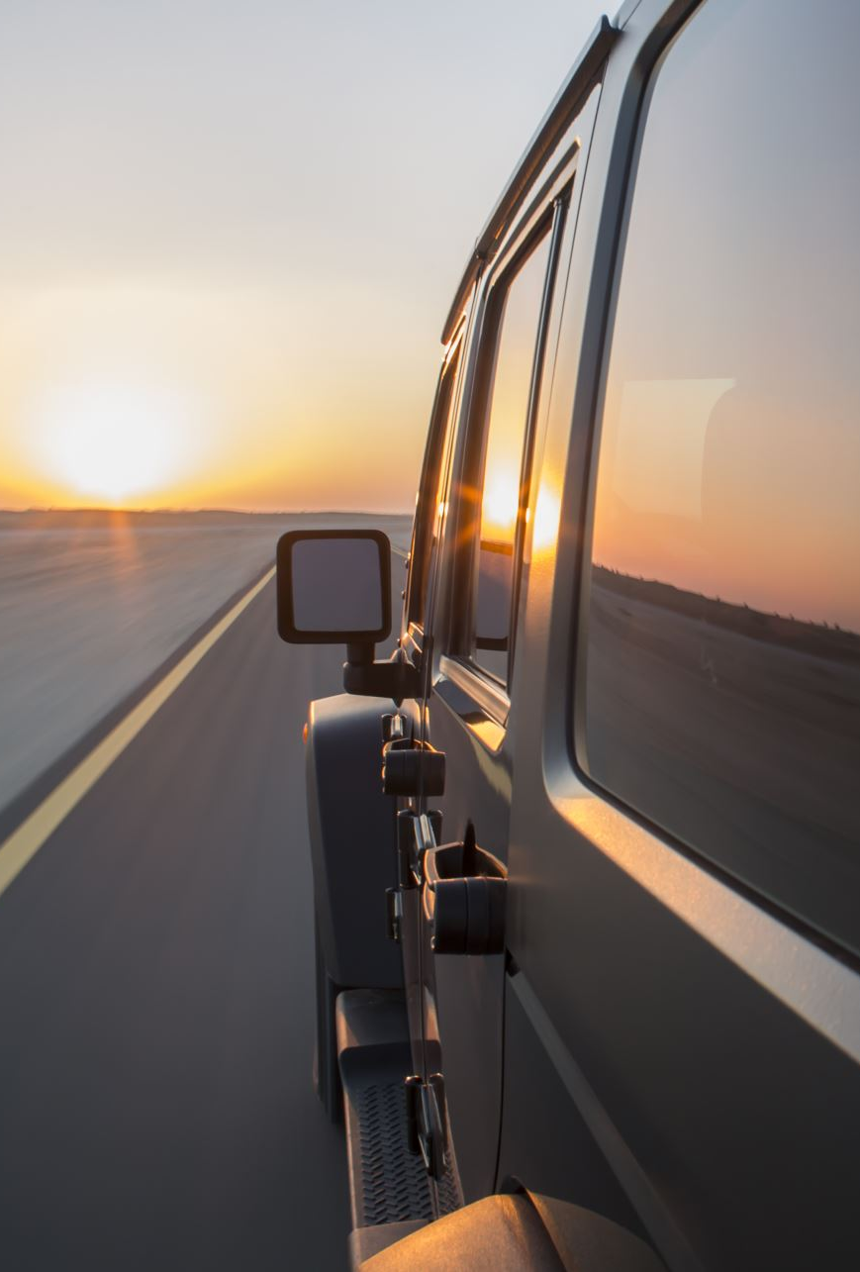
Advancements in Steering Angle Prediction: Deep Learning Approaches for Self-Driving Cars
MSc Research Project - National College of Ireland MSc Artificial Intelligence
School of Computing
National College of Ireland
Rahul Goswami
Student ID: X23167572
Supervisor: Arundev Vamadevan
Date: 12/12/2024

Slide 2
Overview of Autonomous Driving and Deep Learning Models
Definition:
Autonomous driving allows vehicles to operate independently using sensors, cameras, and machine learning algorithms.
Deep learning identifies patterns in driving data to enable decision-making and control.
Levels of Autonomy:
Level 0: Fully manual control.
Level 1: Basic automation (e.g., adaptive cruise control).
Level 2: Automated steering and acceleration with human oversight.
Level 3: Conditional automation; driver may disengage but must intervene if needed.
Level 4: High automation in controlled conditions.
Level 5: Full autonomy using advanced sensors and machine learning.
Models Explored:
PilotNet: Uses convolutional layers for steering angle prediction with robust data augmentation.
Improved Nvidia Model: Incorporates YUV colour transformation, normalization, and mean squared error optimization.
CNN-RNN Hybrid: Combines CNNs for spatial features with LSTMs for temporal dependencies.

Slide 3
Research Question & Goal
RQ:
How can deep learning improve steering angle predictions for autonomous vehicles?
SRQ:
Comparative strengths and weaknesses of PilotNet, Enhanced Nvidia, and CNN-RNN models.
Goal:
Identify the most effective model for steering angle prediction to enhance safety and reliability in autonomous vehicles.

Slide 4
Evolution of Deep Learning for Steering Angle Prediction
Overview:
The research reviewed multiple papers to trace the advancements in steering angle prediction for autonomous vehicles.
Progression observed from early CNN models to advanced hybrid architectures and optimization techniques.
Beginning:
Early CNN models like PilotNet introduced end-to-end learning for steering tasks, focusing on spatial feature extraction.
Limitations emerged in handling dynamic and unstructured environments.
Progression:
Recent models incorporated preprocessing techniques such as YUV transformation, normalization, and data augmentation.
Hybrid CNN-RNN frameworks with LSTM layers captured temporal dependencies, improving performance in dynamic scenarios.

Slide 5

Evolution of Deep Learning for Steering Angle Prediction, contd…
Current Innovations:
Sensor fusion methods integrate LIDAR, radar, and GPS with visual data for better contextual understanding.
Optimization strategies like quantization and pruning enable real-time application on edge devices.
Domain adaptation aligns simulated data with real-world scenarios, improving robustness.
Conclusion:
The evolution highlights a trend toward models that balance accuracy, robustness, and computational efficiency.
Future research focuses on multimodal data fusion, domain-specific augmentations, and scalable architectures for deployment.

Slide 6
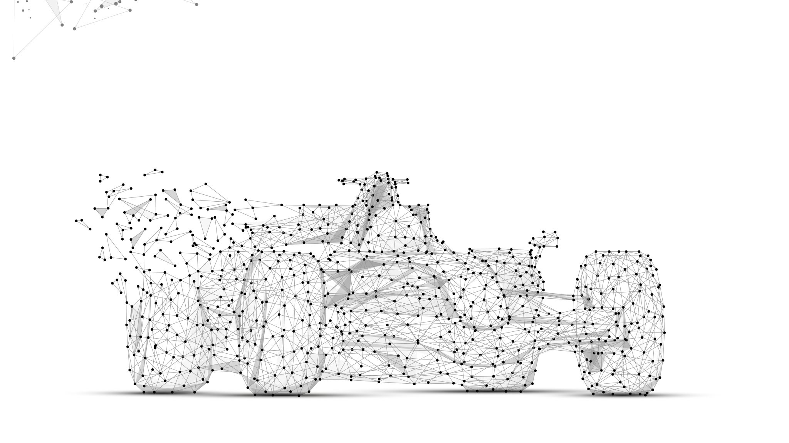
Methodology
PilotNet:
Architecture:
End-to-end CNN model for steering prediction.
Processes 66x200 RGB images from a front-facing camera.
Uses convolutional layers followed by ReLU activation for feature extraction.
Strengths:
Efficient in regulated environments like Udacity Simulator.
Focuses on lane detection and smooth steering control.
Loss Function: Mean Squared Error (MSE) minimizes the difference between predicted and actual steering angles.
2) Enhanced Nvidia Model:
Architecture:
Builds on PilotNet with additional convolutional layers.
Incorporates preprocessing (YUV transformation, normalization).
Strengths:
Enhanced lane-following performance in controlled scenarios.
Extracts more complex patterns for reliable trajectory control.
Loss Function: MSE optimizes learning from raw pixel inputs.

Slide 7
Methodology, Contd…
3) Hybrid CNN-RNN Model
Architecture:
Combines CNN for spatial feature extraction and RNN (LSTM) for temporal dependency analysis.
Input: Cropped 66x200 RGB images.
CNN:
Extracts lane markings and road features.
Batch normalization and dropout improve training stability.
RNN (LSTM):
Captures frame-to-frame temporal relations.
Recognizes short- and long-term dependencies using gate mechanisms.
Strengths:
Predicts road characteristics and direction over time.
Effective in understanding sequential environments, improving steering reliability.
Training:
End-to-end learning with MSE loss.
Evaluated in the Udacity Simulator.

Slide 8
Design
1) PilotNet Model
Overview:
End-to-end CNN architecture by Nvidia for steering angle prediction.
Trained on the Udacity simulator with RGB images resized to 66x200 pixels.
Key Features:
Convolutional Layers:
Extract spatial features like lane markings and road curvature.
ReLU activation enables learning of complex patterns.
Fully Connected Layers:
Combine spatial features into a single steering angle output.
Training:
Optimized using Mean Squared Error (MSE) to mimic human driving patterns.
Application:
Suitable for simple, controlled environments focusing on lane following.
Count of layers | Input | Layer Type | Output | Layer Activated
1st Layer | 3*66*200 | Convolutional Layer | 24*31*98 | Relu Activation
2nd Layer | 24*31*98 | Convolutional Layer | 36*14*47 | Relu Activation
3rd Layer | 36*14*47 | Convolutional Layer | 48*5*22 | Relu Activation
4th Layer | 48*5*22 | Convolutional Layer | 64*1*18 | Relu Activation
5th Layer | 64*1*18 | Flatten Layer | 1152 | Null
6th Layer | 1152 | Fully Connected Layer | 100 | Relu Activation
7th Layer | 100 | Fully Connected Layer | 50 | Relu Activation
8th Layer | 50 | Fully Connected Layer | 10 | Relu Activation
9th Layer | 10 | Output Layer | 1 | Null

Slide 9
Design, contd…
2) Enhanced Nvidia Model
Overview:
An extended version of the original Nvidia architecture.
Adds more convolutional layers for better feature extraction and road analysis.
Key Features:
Enhanced Convolutional Architecture:
Detects complex spatial patterns for lane boundaries and road edges.
Includes ReLU activations for non-linear feature learning.
Fully Connected Layers:
Merge extracted features to predict the steering angle.
Preprocessing:
YUV color transformation and normalization for robust performance.
Application:
Effective for lane-following tasks in controlled environments.
Focused solely on spatial features, excluding interactions with traffic or pedestrians.
Count of layers | Input | Layer Type | Output | Layer Activated
1st Layer | 3*66*200 | Normal Layer | 3*66*200 | Null
2nd Layer | 3*66*200 | Convolutional Layer | 24*31*98 | elu Activation
3rd Layer | 24*31*98 | Convolutional Layer | 36*14*47 | elu Activation
4th Layer | 36*14*47 | Convolutional Layer | 48*5*22 | elu Activation
5th Layer | 48*5*22 | Convolutional Layer | 64*3*20 | elu Activation
6th Layer | 64*3*20 | Convolutional Layer | 64*1*18 | elu Activation
7th Layer | 64*1*18 | Flatten Layer | 1152 | Null
8th Layer | 1152 | Fully Connected Layer | 100 | elu Activation
9th Layer | 100 | Fully Connected Layer | 50 | elu Activation
10th Layer | 50 | Fully Connected Layer | 10 | elu Activation
11th Layer | 10 | Output Layer | 1 | Null

Slide 10
Design, contd…
3) Hybrid CNN-RNN Model (CNN-LSTM)
Overview:
Combines CNN for spatial feature extraction and LSTM for temporal dependency analysis.
Processes sequential data from the Udacity simulator.
Key Features:
CNN Component:
Extracts lane markings and road edges through convolutional layers.
Incorporates ReLU activation, pooling, and dropout for robustness.
LSTM Component:
Captures temporal relationships across sequential frames.
Uses input, forget, and output gates for memory control.
Final Layers:
Fully connected layers refine predictions for the steering angle.
Application:
Ideal for dynamic environments requiring temporal awareness.
Effective in controlled simulations, focused on road information and vehicular dynamics.
Count of layers | Input | Layer Type | Output | Layer Activated
1st Layer | 3*66*200 | Input Layer | 3*66*200 | Null
2nd Layer | 3*66*200 | Convolutional Layer | 24*31*98 | Relu Activation
3rd Layer | 24*31*98 | Batch Normalization | 24*31*98 | Null
4th Layer | 24*31*98 | Dropout Layer | 24*31*98 | Null
5th Layer | 24*31*98 | Convolutional Layer | 36*14*47 | Relu Activation
6th Layer | 36*14*47 | Batch Normalization | 36*14*47 | Null
7th Layer | 36*14*47 | Dropout Layer | 36*14*47 | Null
8th Layer | 36*14*47 | Convolutional Layer | 48*5*22 | Relu Activation
9th Layer | 48*5*22 | Batch Normalization | 48*5*22 | Null
10th Layer | 48*5*22 | Dropout Layer | 48*5*22 | Null
11th Layer | 48*5*22 | Convolutional Layer | 64*3*20 | Relu Activation
12th Layer | 64*3*20 | Batch Normalization | 64*3*20 | Null
13th Layer | 64*3*20 | Dropout Layer | 64*3*20 | Null
14th Layer | 64*3*20 | Convolutional Layer | 64*1*18 | Relu Activation
15th Layer | 64*1*18 | Batch Normalization | 64*1*18 | Null
16th Layer | 64*1*18 | Dropout Layer | 64*1*18 | Null
17th Layer | 64*1*18 | Flatten Layer | 1152 | Null
18th Layer | 1152 | Fully Connected Layer | 100 | Relu Activation
19th Layer | 100 | Dropout Layer | 100 | Null
20th Layer | 100 | Fully Connected Layer | 50 | Relu Activation
21st Layer | 50 | Dropout Layer | 50 | Null
22nd Layer | 50 | Fully Connected Layer | 10 | Relu Activation
23rd Layer | 10 | Reshape Layer | 1*100 | Null
24th Layer | 1*100 | LSTM Layer | 50 | Tanh Activation
25th Layer | 50 | Output Layer | 1 | Null

Slide 11
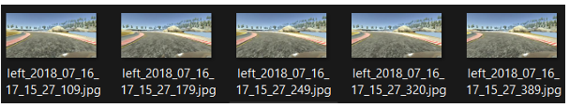
Dataset Preparation and Processing
Dataset Description:
Data from Udacity Simulator includes:
Images from center, left, and right cameras.
Driving log with steering angle, throttle, brake, and speed.
Images represent varying road conditions, bends, and lighting scenarios.
Steering angle is the primary target variable for training.
Preprocessing Steps:
Images resized to 66x200 pixels, converted to YUV color space, and normalized to [0,1].
Cropping removed irrelevant features (e.g., sky, car hood).
Steering angle distribution balanced using data augmentation (zoom, flipping, brightness adjustment).
Dataset Splitting:
Training (80%) and validation (20%) split.
Ensured equal representation of straight, left, and right steering data.
Key Techniques:
Batch generation for real-time preprocessing.
Batch normalization and dropout layers for stability and generalization.

Slide 12
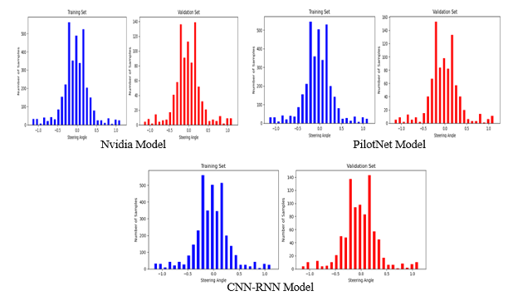
Dataset Preparation and Processing contd…
Training Process:
All models (PilotNet, Enhanced Nvidia, Hybrid CNN-RNN):
Trained on preprocessed data with ground-truth steering angles.
Objective: Minimize Mean Squared Error (MSE) between predicted and actual angles.
Adaptive optimization with Adam optimizer.
Hybrid CNN-RNN:
Used LSTM layers for temporal sequence learning.
Learned time-dependent road transitions (e.g., curves, straight paths).
Testing Phase:
Validation on unseen data (20% split).
Models tested on straight roads, sharp curves, and gentle turns.
Adjustments made based on training and validation loss trends to prevent overfitting/underfitting.

Slide 13
Model Development
PilotNet:
Light network architecture convolutional layers for spatial feature extraction.
Fully connected layers predict steering angles.
Achieves a balance between accuracy and computational efficiency.
Enhanced Nvidia Model:
Builds on PilotNet by adding:
Max pooling, batch normalization, and dropout layers.
Improves generalization and reduces overfitting.
Results in lower Mean Absolute Error (MAE) and Root Mean Squared Error (RMSE) compared to other models.
Hybrid CNN-RNN Model:
Combines CNN for spatial patterns and LSTM for temporal dependencies.
Ideal for dynamic driving scenarios with sequential frames.
Captures both spatial and temporal relationships for robust steering predictions.

Slide 14
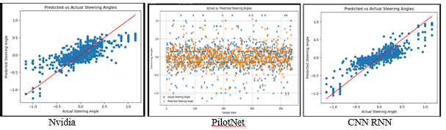
Model Training and Outputs
Training Process:
Data split into 80% training and 20% validation.
Used Adam optimizer with MSE loss and a batch size of 32.
Early stopping applied to prevent overfitting.
Learning rates tuned individually for each model.
Outputs:
.h5 model files for PilotNet, Enhanced Nvidia, and CNN-RNN.
Visualizations:
Training and validation loss curves.
MAE, RMSE, and inference time.
Scatter plots comparing actual and predicted steering angles.
Observations:
Enhanced Nvidia Model: Best generalization, suited for various road scenarios.
PilotNet: Computationally efficient, ideal for resource-constrained systems.
Hybrid CNN-RNN: Excels in temporal feature capture but demands higher computational resources.

Slide 15
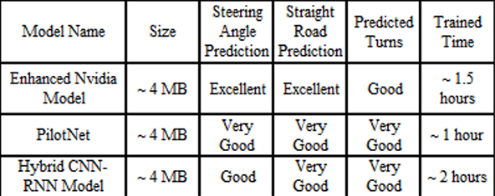
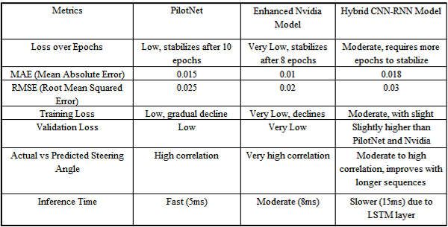
Performance Evaluation Summary
PilotNet Model:
Size: ~4 MB
Steering Prediction: Very Good
Inference Time: Fast (5ms)
Best suited for resource-constrained environments with simple scenarios.
Enhanced Nvidia Model:
Size: ~4 MB
Steering Prediction: Excellent
Validation Loss: Very Low
Trades computational efficiency for accuracy and robustness.
Hybrid CNN-RNN Model:
Size: ~4 MB
Steering Prediction: Good for dynamic scenarios
Temporal Understanding: Superior due to LSTM
Slower inference due to added complexity (~15ms).

Slide 16
Conclusion and Future Work
PilotNet:
Highly efficient for simple environments.
Struggles in dynamic conditions.
Enhanced Nvidia Model:
Balanced performance in accuracy, efficiency, and adaptability.
Strong for general tasks, low validation loss.
Hybrid CNN-RNN:
Excels in temporal understanding for dynamic scenarios.
Computationally expensive but robust.
Best Model:
The Enhanced Nvidia Model emerged as the best performer, striking a balance between computational efficiency and accuracy.
It demonstrated excellent generalization capabilities, low validation loss, and high adaptability, making it ideal for real-world applications.
Future Directions:
Validate models on diverse, naturalistic driving data.
Employ model quantization and pruning for real-time optimization.
Integrate LIDAR and GPS for complex environments.
Aim for scalable, robust models for real-world deployment.

Slide 17
Conclusion, CONTD…
Percentage Improvement = Metrics (Other Model) – Metrics (ENV) x 100 The Enhanced Nvidia Model outperforms:
Metrics (Other Model) 1) PilotNet by 33.33% (MAE) and 20.0% (RMSE)
2) Hybrid CNN-RNN by 44.44% (MAE) and 33.33% (RMSE).
ENV Comparison with PilotNet:
MAE Improvement = 0.015−0.01​ x 100 = 33.33%
0.015
RMSE Improvement: = 0.025−0.02​ x 100 = 20%
0.025
ENV Comparison with CNN-RNN:
MAE Improvement = 0.018−0.01​ x 100 = 44.44%
0.018
RMSE Improvement: = 0.03−0.02​ x 100 = 33.33%
0.03

